Slide 1


Recursion Using recursion in Pre-order Traversal
- Akshay Dhillon

Slide 2
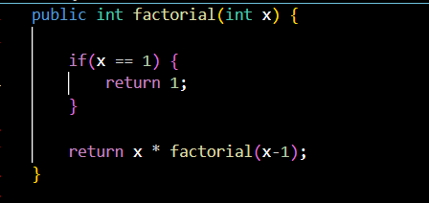
Recursion
In the previous tutorial we learned what Recursion is, using a factorial example.
Now lets see how can we use recursion in Tree Traversals

Slide 3
Recursion
Lets assume we have a Binary Tree:
Pre-order traversal:
When we visit the nodes in the following orders:
Root node
Left Node
Right Node
Pre-order Traversal of this given tree would be
1->2->4->5->3->6->7
1
2
3
4
5
6
7

Slide 4
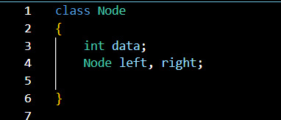

Recursion
Pre-order traversal:
Pre-order Traversal of this given tree would be
1->2->4->5->3->6->7
How can we solve this using Recursion?
Simple Process Root Node, then Left Node, then Right Node and repeat this till all roots are traversed!
Lets assume we have a Binary Tree:
1
1
Each node has data, pointer to left and right nodes
2
3
4
5
6
7

Slide 5
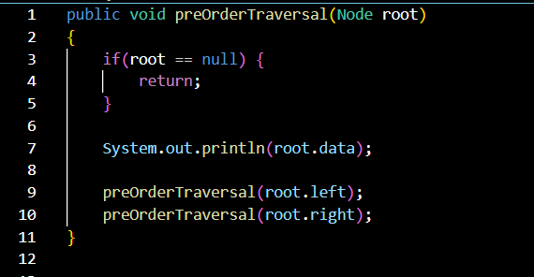

Recursion
Pre-order traversal:
Pre-order Traversal of this given tree would be
1->2->4->5->3->6->7
Lets write some code in Java for this:
As you can see, this code written using recursion is so easy to understand! ☺
1
2
3
4
5
6
7

Slide 6
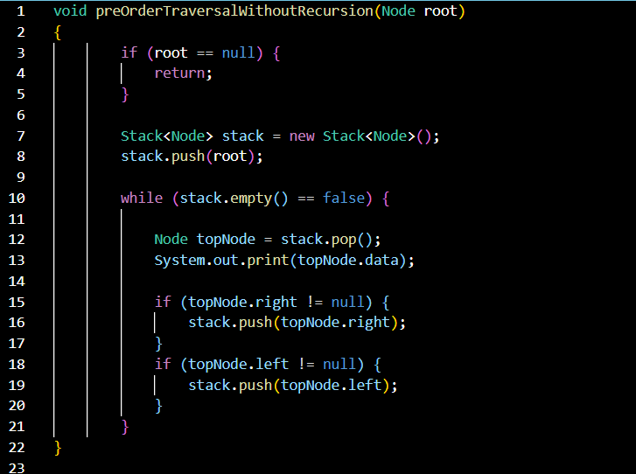
Recursion
Pre-order traversal:
Pre-order Traversal of this given tree would be
1->2->4->5->3->6->7
Java code without using recursion for Preorder traversal
1
2
3
4
5
6
7

